Slide 1
React JS
(the usestate() hook)
Lecture-32

Slide 2
Today’s Agenda
Introduction To useState() Hook
Syntax Of useState()
Examples
Exercise

Slide 3
The useState() Hook
It is the most important and often used hook and is used to initialize state and manipulate it with a setter method.
Syntax:
const[ <var1>,<var2>]=useState(<value>);
The argument passed to useState() is the actual initial state, and its return value is an array of two elements:
the actual value for the state
the state updater function for the created state

Slide 4
Exercise 1
Create a Functional Component which displays a button titled Click Me
When the button is clicked the text in the button must be replaced with current date and time

Slide 5
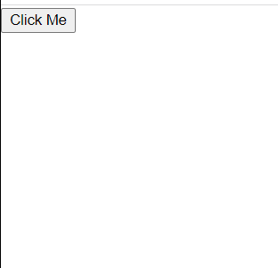
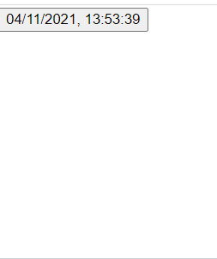
Desired Output
Before Click
After Click

Slide 6
Solution 1
MyButton.js
import { useState } from "react";
function MyButton() {
const [text, setText] = useState("Click Me");
function changeText() {
setText(new Date().toLocaleString());
}
return (
<div>
<button onClick={changeText}>{text}</button>
</div>
);
}
export default MyButton;

Slide 7
Solution 1
App.js
import MyButton from "./MyButton";
function App() {
return (
<div className="App">
<MyButton />
</div>
);
}
export default App;

Slide 8
Solution 2
MyButton2.js
import { useState } from "react";
function MyButton2() {
const [text, setText] = useState("Click Me");
const changeText = () => {
setText(new Date().toLocaleString());
};
return (
<div>
<button onClick={changeText}>{text}</button>
</div>
);
}
export default MyButton2;

Slide 9
Solution 3
MyButton3.js
import { useState } from "react";
function MyButton3() {
const [text, setText] = useState("Click Me");
return (
<div>
<button onClick={() => setText(new Date().toLocaleString())}>
{text}
</button>
</div>
);
}
export default MyButton3;

Slide 10
Exercise 2
Create a Functional Component which displays a button titled Click Me and a counter initially set to 0
When the button is clicked the counter should increment by 1

Slide 11
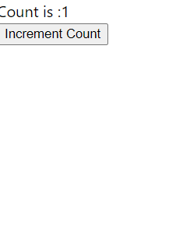
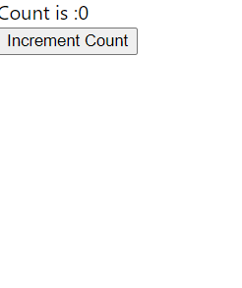
Desired Output
Before Click
After Click

Slide 12
Solution 1
MyCounter.js
import { useState } from "react";
function MyCounter() {
const [count, setCount] = useState(0);
const incrementCount = () => {
setCount(count + 1);
};
return (
<div>
<section>Count is :{count}</section>
<button onClick={incrementCount}>Increment Count</button>
</div>
);
}
export default MyCounter;

Slide 13
Solution 2
MyCounter2.js
import { useState } from "react";
function MyCounter2() {
const [count, setCount] = useState(0);
const incrementCount = () => {
setCount((prevCount) => prevCount + 1);
};
return (
<div>
<section>Count is :{count}</section>
<button onClick={incrementCount}>Increment Count</button>
</div>
);
}
export default MyCounter2;

Slide 14
Exercise 3
Create a Functional Component which displays two textboxes for typing firstname and lastname
When the user types text in any of them , the text from both the textboxes should be displayed prefixed with Hello in the page

Slide 15
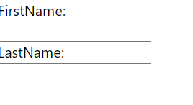
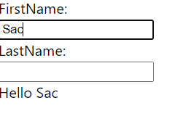
Desired Output
Before typing text
After typing

